Slide 1

NETFLIX

Slide 2
SQL project
This project aims to analyze Netflix's data through SQL to gain insights into viewer preferences and content performance. Utilizing a dataset that includes user interactions and content metadata, the analysis will focus on key metrics like user engagement, content popularity, and churn rates. By executing complex SQL queries and performing data transformations, I will uncover trends that can inform content strategy and marketing efforts. The ultimate goal is to enhance user experience and support data-driven decision-making within the streaming industry, showcasing my SQL proficiency and analytical skills.

Slide 3
Project Objectives
Analyze the distribution of content types (movies vs TV shows).
Identify the most common ratings for movies and TV shows.
List and analyze content based on release years, countries, and durations.
Explore and categorize content based on specific criteria and keywords.
Dataset

Slide 4
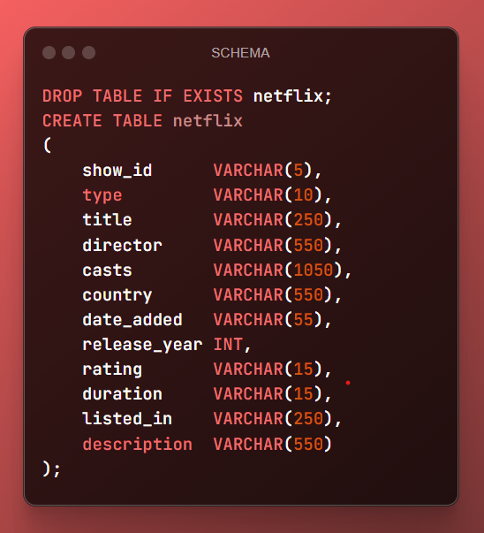
SCHEMA OF TABLE NETFLIX

Slide 5
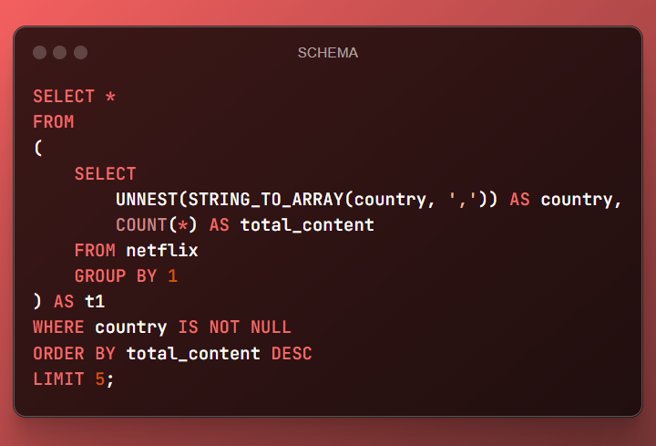
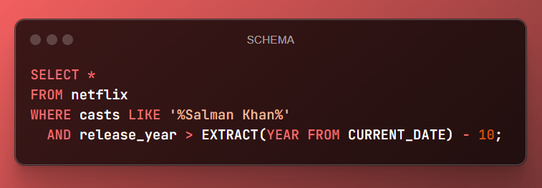

Slide 6
Findings and Conclusion
Content Distribution: The dataset contains a diverse range of movies and TV shows with varying ratings and genres.
Common Ratings: Insights into the most common ratings provide an understanding of the content's target audience.
Geographical Insights: The top countries and the average content releases by India highlight regional content distribution.
Content Categorization: Categorizing content based on specific keywords helps in understanding the nature of content available on Netflix.
Next
Studio
Production Company (distributor)
Production Company (producer)
Director (usually as “A ‘Director’ Film”)
FILM TITLE
Main Cast
Supporting Cast
Casting Director
Composer
Costume Designer
Associate Producer(s)
Editor
Production Designer
Cinematographer
Executive Producer
Producer
Writer(s)
Director (Second reference)

Slide 7
thanks

